Slide 1
Introduction to Programming
Session 01
Introduction to Programming language

Slide 2
Objectives
Introduction to Java programming language
Why Java?
Java IDE
Hello, world.
Basic syntax
Variable, Constant
Data types
Console Input-Output
Notes:
https://niithanoi.edu.vn/nen-hoc-java-hay-c-sharp.html

Slide 3
Java programming language
1996
JDK 1.0
1998
J2SE 1.2
2000
J2SE 1.3
Was given a codename “KESTREL” and was released on 8th May, 2000
JDK 1.0 very first version was released on Jan 23, 1996
The principal stable variant, JDK 1.02, is called Java 1. JDK 1.1 was released on Jan 23, 1997
“Play area” was the codename which was given to this form and was released on 8th Dec, 1998.
It real expansion included: strictfp keyword, the Swing graphical API
Contains addition like HotSpot, JMV included, Java Naming and Directory Interface.
2002
J2SE 1.4
Was given a codename “Merlin” and was released on 6th Feb, 2002
Contains addition like Library Improvements, Regular expressions modelled after Perl regular Expressions.
2004
J2SE 5.0
Was given a codename “Tiger” and was released on 30th Sep, 2004
Originally numbered as 1.5 which is still used as its internal version. Added several new language features such as for-each loop
2006
Java SE6
Was given a codename “Mustang” and was released on 11th Dec, 2006
Package with database supervisor and encourages the utilization of scripting

Slide 4
Java programming language
2014
Java SE8
2017
Java SE9
Was released on 21th Sep, 2017.
Was released on 18th Mar, 2014.
Language level support for lambda expressions, default methods and new date and time API inspried by Joda Time
Projects Jigsaw: designing and implementing a standard, module system for the Java SE platform, and to apply that systems to the platform itself and the JDK
2018
Java SE 10
Was released on 20th Mar, 2018
Contains addition like additional Unicode language-tag extenstions , Root certificates, Thread-local handshakes, Heap allocation on alternative memory devices.
2018
Java SE 11
Was released on 25th Sep, 2018
Contains addition like Dynamic class-file constant, Epsilon: a no-op garbage collector, local-variable syntax for lambda parameters, Low-overheap heap profiling.
2019
Java SE 12
Was released on 19th Mar, 2019
Contains addition like Shenandoah: a Low-Pause-Time Garbage Collector (Experimental) Microbenchmark Suite, Switch Expressions (Preview), JVM constants API.
2011
Java SE7
Add small language changes including string in switch. The JVM was extended with support for dynamic languages
Was given a codename “Dophin” and was released on 7th July, 2011

Slide 5
Why Java?
Java is an object-oriented programming language (OOP), multi-purpose and platform independent. Instead of compiling to machine code on a specific platform, java code is compiled into bytecode – an intermediate format. The bytecode will then be run by the execution environment
In other words, java code "writes once, runs anywhere". It will work on any device running the operating system, as long as the Java Runtime Environment (JRE) is installed.
Java is the popular choice for many reasons:
  employment opportunities
  free
  extensive source code gallery
  support documenting with javadoc
  strong, dynamic and engaging user community

Slide 6
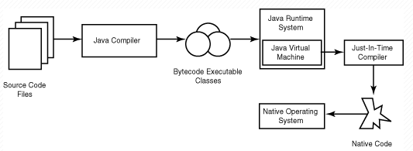
Compile and Excute program

Slide 7
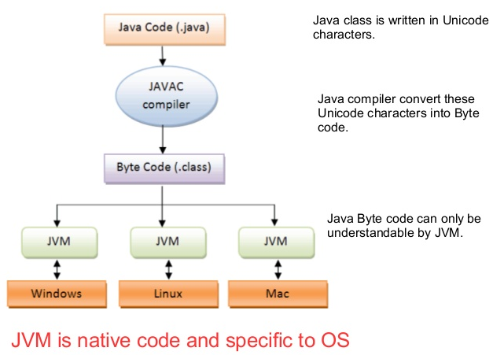
Compile and Excute program

Slide 8
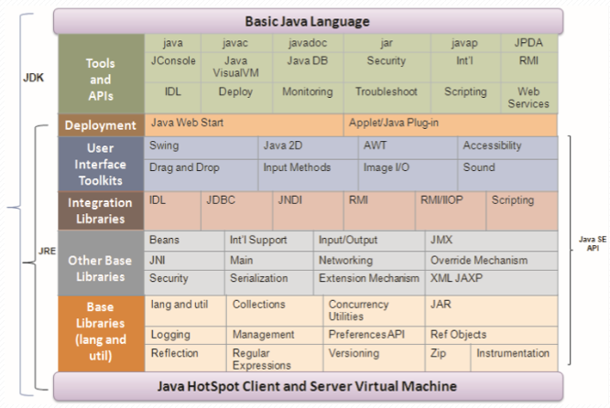
Java SE Platform
JRE (Java Runtime Environment): provides JVM (Java Virtual Machine) and library used to run Java programs.
JDK (Java Development Kit): includes the compiler and debugger used to develop Java applications.

Slide 9
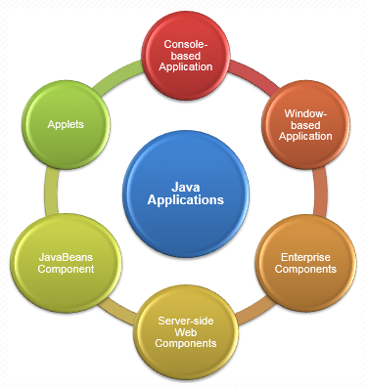
Java applications

Slide 10
Java IDE
You can open a basic text editor like notepad and start writing basic Java programs or continue with the integrated development environment (IDE).
Some Java IDE:
  NetBeans,
  Eclipse Java IDE,
  JDeveloper,
  Android Studio,
  MyEclipse
  JEdit.
  IntelliJ IDEA
  Visual Studio Code-Plugin Java
Notes:
https://www.techlead.vn/java-ide-10-ide-tot-nhat-cho-cac-lap-trinh-vien-java/

Slide 11
Hello, world
import java.io.*;
public class HelloWorld
{
// Your program begins with a call to main().
public static void main(String args[])
{
/*Prints "Hello, World" to the terminal window. */
System.out.println("Hello, World");
}
}

Slide 12
Hello, world
Line 1 import java.io.* is a library declaration command.
In Java, every line of code that can actually run needs to be inside a class. Line 2 public class HelloWorld declares a class named HelloWorld, which is public, that means that any other class can access it.
Line 4 or 7 //… or /*…*/ will be ignored by the compiler and it is called comments in the program.
Line 5 public static void main(String[] args) this is the entry point of a Java program.
Line 8 System.out.println("Hello, World") is a method that can be used to print a line to the screen, it is a part of System class that is a pre-defined class in Java and it holds some useful methods and variables.

Slide 13
Basic syntax
Tokens:
  A Java program consists of various.
  A token is either a keyword, an identifier, a constant, a string literal or a symbol.
Semicolons:
  The semicolon (;) is a statement terminator.
  Each individual statement must be ended with a semicolon.
  It indicates the end of one logical entity.
Comments:
  Comments are like helping text in java program & they are ignored by the compiler.
  Examples: // Your program begins with a call to main().
  /*Prints "Hello, World" to the terminal window. */

Slide 14
Basic syntax
Identifiers:
  Identifier is a concept used to name a variable, constant, function, class, ... in the program
  It is conventionally named as follows:
    start with a letter or _
    do not contain special characters such as @, #, ...
    cannot match keywords in java language
  Java is a case-sensitive programming language.
  Examples:
  myName ivalue _value retVal
  add123 j a_b_c T

Slide 15
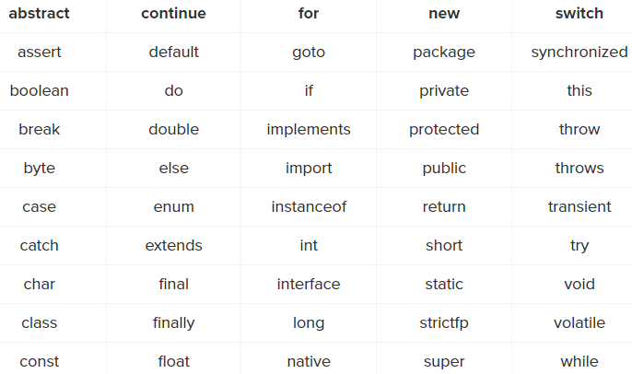
Basic syntax
Keywords: The following list shows the reserved words in Java. Keywords in java:

Slide 16
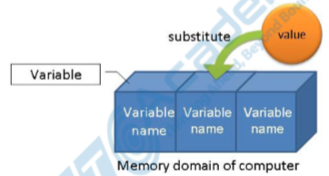
Variable
Helps the system create memory areas to store values in the application.
Each variable has its own data type, which varies in size depending on the data type - indicating the ability to store the value of the variable.
Each variable must also be given a name / identifier to help the system manage and access data in its memory.

Slide 17
Variable declaration
Syntax variable declaration in java
<data type> <variable_name> [= value];
Examples:
  double salary;
  int count = 0;
  boolean done = false;
  long earthPopulation;

Slide 18
Constant
Constants are similar to variables, but especially if a variable is declared as a constant, it will not be changed during the program.
To declare a constant in JAVA, we add final before the variable declaration syntax and must assign it a value..
<final> <data type> <constant_name = value>;
Examples:
  final float PI = 3.14f;
  final char FIRST_CHARACTER = 'a';
  final int VIP_TYPE = 1;

Slide 19
Data type
The data type tells the system how big a variable / constant is, this magnitude indicates the ability to store the value of the variable.
Choosing a data type for a variable depends on the problem to be solved. Usually we should rely on the function or ability to store the value of that variable.
Data types in JAVA include: “primitive” type and “extended/reference” type.

Slide 20
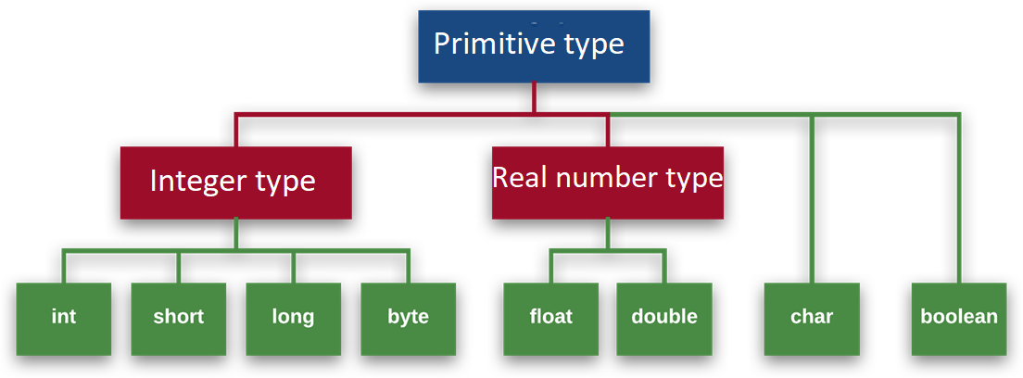
Data type – primitive type

Slide 21
Data type
The data type tells the system how big a variable / constant is, this magnitude indicates the ability to store the value of the variable.
Choosing a data type for a variable depends on the problem to be solved. Usually we should rely on the function or ability to store the value of that variable.
Data types in JAVA include: “primitive” type and “extended/reference” type.

Slide 22
Data type
The data type tells the system how big a variable / constant is, this magnitude indicates the ability to store the value of the variable.
Choosing a data type for a variable depends on the problem to be solved. Usually we should rely on the function or ability to store the value of that variable.
Data types in JAVA include: “primitive” type and “extended/reference” type.

Slide 23
Data type – primitive type

Slide 24
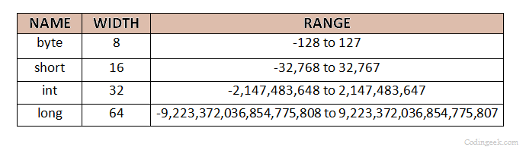
Data type – integer type
For example:
  correct:
    byte month = 5;
    short salaryUSD = 2000;
  Incorrect:
    byte day = 365;
    short salaryVND = 40000000;
Note: If no value is declared for the variable, the integer variable type will default to 0 (or 0L for long type).
Notes:
Khi sử dụng kiểu dữ liệu cho biến bạn phải cân nhắc đến độ lớn lưu trữ của chúng. Bạn không nên lúc nào cũng sử dụng kiểu dữ liệu long cho tất cả các trường hợp vì như vậy sẽ làm tiêu hao bộ nhớ của hệ thống khi chương trình được khởi chạy. Bạn nên biết giới hạn của biến để đưa ra kiểu dữ liệu phù hợp. Ví dụ nếu dùng biến để lưu trữ các tháng trong năm, thì kiểu byte là đủ. Hoặc dùng biến để lưu tiền lương của nhân viên theo VND, thì dùng kiểu int, nhưng nếu chương trình của bạn lưu trữ toàn người giàu thì lương có thể được sử dụng kiểu long

Slide 25
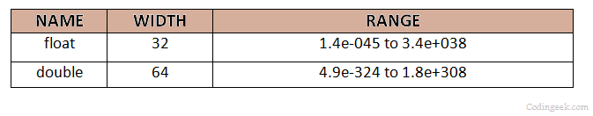
Data type – real number type
This type is used to store and calculate real numbers, which are floating-point numbers, including:
For example:
  float rating = 3.5f;
  double radius = 34.162;
Note: If no value is declared for the variable, then the actual numeric variable has a default value of 0.0f for the float type and 0.0d for the double type.
Notes:
Sở dĩ với kiểu float ở trên phải để chữ f vào cuối khai báo float rating = 3.5f; là vì thỉnh thoảng chúng ta phải nhấn mạnh cho hệ thống biết rằng chúng ta đang xài kiểu float chứ không phải kiểu double, nếu bạn không để thêm f vào cuối giá trị thì hệ thống sẽ báo lỗi. Tương tự bạn cũng có thể khai báo double radious = 34.162d; nhưng vì hệ thống đã hiểu đây là số double rồi nên bạn không có chữ d trong trường hợp này cũng không sao.

Slide 26
Data type – char type
The char type has a width of 1 byte, used to store a character enclosed in single quotes ('') like: 'a', 'B' ...
For example:
  Correct:
    char thisChar = 'a';
    char gender = ‘M ';
  Incorrect:
    char thisCharFail1 = "a";
    char thisCharFail2 = b;
    char thisCharFail3 = 'ab';
Notes:
Ngoài việc khai báo như trên, kiểu char còn được dùng theo mã Unicode. Mã Unicode bắt đầu bằng ‘\u0000’ và kết thúc bằng ‘\uffff’. Lưu ý là với cách dùng kiểu mã Unicode này, bạn vẫn phải dùng nháy đơn cho việc khai báo. Ký hiệu \u cho biết bạn đang dùng với mã Unicode chứ không phải ký tự bình thường. Với cách khai báo theo kiểu mã Unicode này, bạn có thể đưa vào chương trình một số ký tự đặc biệt, hãy thử thực hành code như sau và in ra log, bạn sẽ thấy hiệu quả của Unicode nhé.

Slide 27
Data type – boolean type
The boolean type in Java is only represented by two values: true and false.
In java, it is used in checking logical conditions, not in calculations.
For example:
  correct: boolean male = true, graduated = false;
  incorrect: boolean male = 1, graduated = 0;
Note: If no value is declared for the variable, then the boolean variable will have a default value of false.
Notes:
bạn cũng không thể gán một kiểu số nguyên về kiểu boolean như trong C/C++ được.

Slide 28
Data type – reference type
In Java, the type created by combining primitive types together called reference types, usually created by classes (will learn more in OOP module).
The reference type created by JAVA and most commonly used is String – it is a combination of character and array type.
Illustrative image: String sayHello = "HELLO"; =>
For example:
  String myName = "My name’s Phong";
  String myAddress = "184 Le Dai Hanh";
  String str = "";
H | E | L | L | O
Notes:
Will learn more through lessons on String

Slide 29
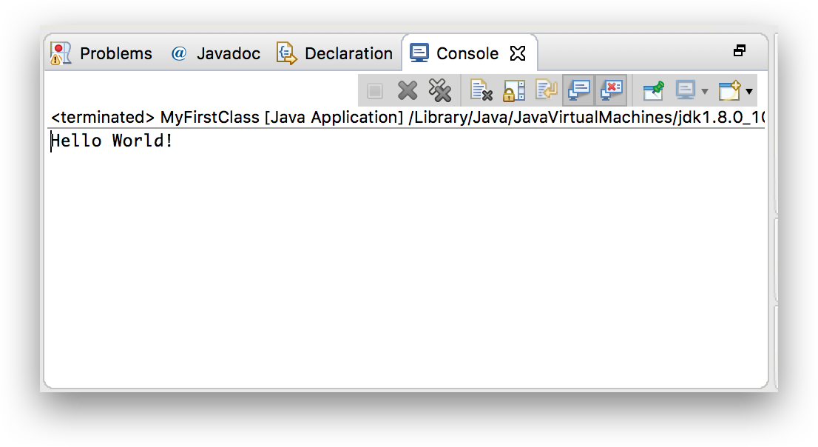
Console Input/output
Console as a dedicated console, in programming languages, Console is known as a simple application control through text lines (command line), it is distinguished from UI control.

Slide 30
Console Input
There are several ways to Input on Console in JAVA, here we only learn how to use Scanner class in the library is package java.util.Scanner
To import, we need to create 1 Scanner object as the following example:
Scanner scanIn = new Scanner (System.in);
Some commonly used methods for input on Console:
  next (), nextLine () enter the string
  nextByte (), nextInt (), nextLong () enter integers of type byte, int, long
  nextFloat (), nextDouble () enter a real number of type float, double
  nextBoolean () enter true / false type (Boolean)
  …
We will learn in detail through the last example.

Slide 31
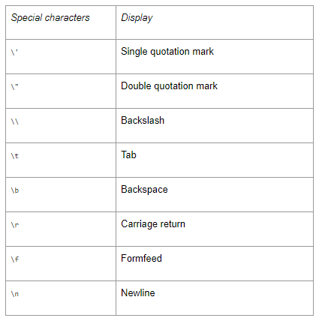
Console output
Output with line breaks:
System.out.println (Format string);
Output without line breaks:
System.out.print (Format string)
Format string: is what needs to be output to the screen.
You can insert several special characters into Format string. The side table shows these special characters; note that each is preceded by a backslash (\).
The java string format() method returns the formatted string by given locale, format and arguments. If you don't specify the locale in String.format() method, it uses default locale by calling Locale.getDefault() method. The format() method of java language is like sprintf() function in c language and printf() method of java language.

Slide 32
Java String format()
Syntax: String.format(String format, Object... args): return a formatted string. Below, that is a table of format specifiers supported by the Java String.
Symbol | Data Type | Output
%a | floating point (except BigDecimal) | Returns Hex output of floating point number.
%b | Any type | "true" if non-null, "false" if null
%c | character | Unicode character
%d | integer (incl. byte, short, int, long, bigint) | Decimal Integer
%e | floating point | decimal number in scientific notation
%f | floating point | decimal number
%g | floating point | decimal number, possibly in scientific notation depending on the precision and value.
%h | any type | Hex String of value from hashCode() method.
%n | none | Platform-specific line separator.
%o | integer (incl. byte, short, int, long, bigint) | Octal number
%s | any type | String value
%t | Date/Time (incl. long, Calendar, Date and TemporalAccessor) | %t is the prefix for Date/Time conversions. More formatting flags are needed after this. See Date/Time conversion below.
%x | integer (incl. byte, short, int, long, bigint) | Hex string.
Notes:
https://www.javatpoint.com/java-string-format

Slide 33
Console output
String name = "N. T. Tien";
char gender = 'M';
int age = 25;
System.out.println("Name: "+name);
System.out.println("Gender: "+gender);
System.out.println("Age: "+age);
System.out.println("Name: "+ name +
"\tGender: "+gender+ "\tAge: "+age);
//or use String.format()
System.out.println(String.format("Name: %s \tGender:
%c\tAge: %d ", name, gender, age));
Notes:
https://www.javatpoint.com/java-string-format

Slide 34
Console Input/output example
import java.util.Scanner;
public class ScannerDemo1 {
public static void main (String [] args) {
Scanner sc = new Scanner (System.in); // declare Scanner object
System.out.print ("Input your Name:");
String name = sc.nextLine(); // enter string
System.out.print ("Input your gender (F / M):");
char gender = sc.next().charAt(0); // enter the character
System.out.print ("Input your age:");
int age = sc.nextInt(); // enter int int
System.out.print ("Input your phone no:");
long mobileNo = sc.nextLong(); // enter integer long
System.out.print ("Input your CGPA:");
double cgpa = sc.nextDouble(); // enter real double number

Slide 35
Console Input/output example
// output values
System.out.println("Name: "+name);
System.out.println("Gender: "+gender);
System.out.println("Age: "+age);
System.out.println("Mobile Number: "+mobileNo);
System.out.println("CGPA: "+cgpa);
}
}

Slide 36
References
https://itviec.com/blog/hoc-lap-trinh-java/
https://gpcoder.com/1638-tong-quan-ve-ngon-ngu-lap-trinh-java/
https://www.learnjavaonline.org/en/
https://www.codingeek.com/java/primitive-data-types-in-java-integers-floating-point-character-and-boolean/
http://www.informit.com/articles/article.aspx?p=30241&seqNum=3
https://yellowcodebooks.com/2016/11/01/java-bai-7-nhapxuat-tren-console/
https://www.geeksforgeeks.org/scanner-class-in-java/
https://www.javatpoint.com/java-string-format

Slide 37


